Slide 1
ECONOMICS FINAL PROJECT
Presentation by Lynn el Moussaoui

Slide 2
01 BANKING MARKET
03 STOCK MARKET
02 Real estate
04 CONCLUSIONS

Slide 3
Project
LIQUIDATION OF 1,00,000$ IN DIVERSE INVESTMENTS
My general approach:
Diverse portfolio
Long term perspective
Monitor investments, checking historical data

Slide 4
01. Banking market

Slide 5
SAVINGS
AMOUNT Earmarked FOR SAVINGS
SAVINGS IN EURO
150,000$
103000 euro*1.06=109180$
SAVINGS IN USD
40820$

Slide 6
Using python, we forecasted the euro to dollar rate in 2024

Slide 7
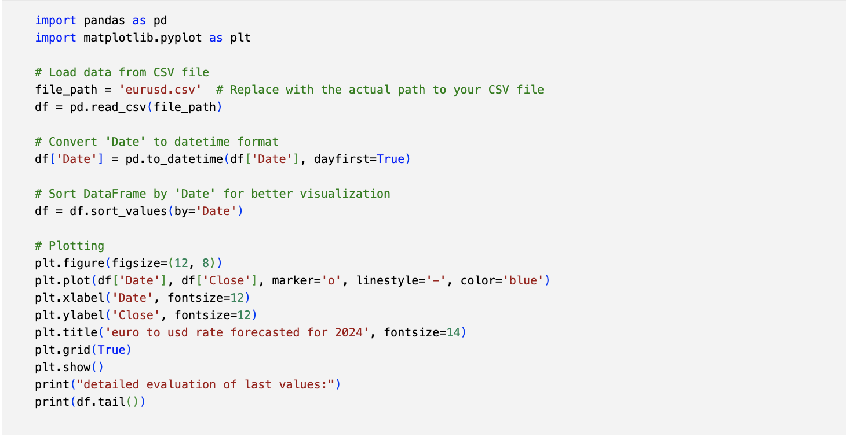
Python code to get euro to usd rate forecast
VENUS

Slide 8
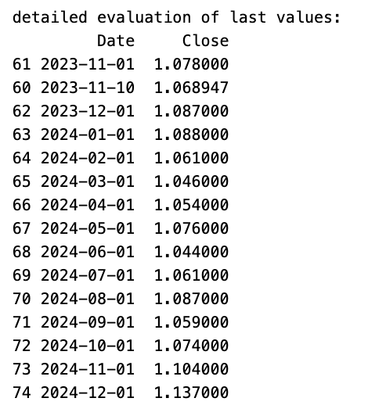
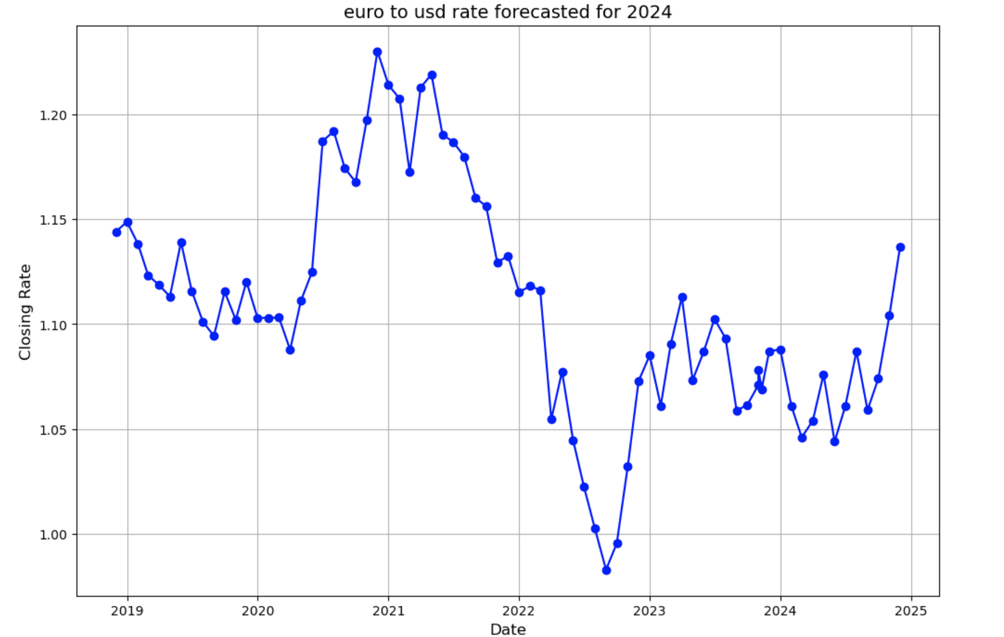
output OF Python code

Slide 9
We decided to invest in 110000 euros in the savings , by using excel and doing the required computations, we get 4686$ as profit similarly by invsting in the remaining 33400 of the 150 000, we get 7$ as profit

Slide 10
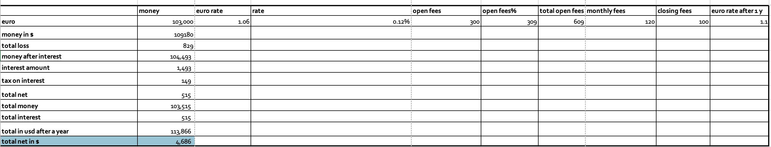
BANKING MARKET: EURO CASE

Slide 11
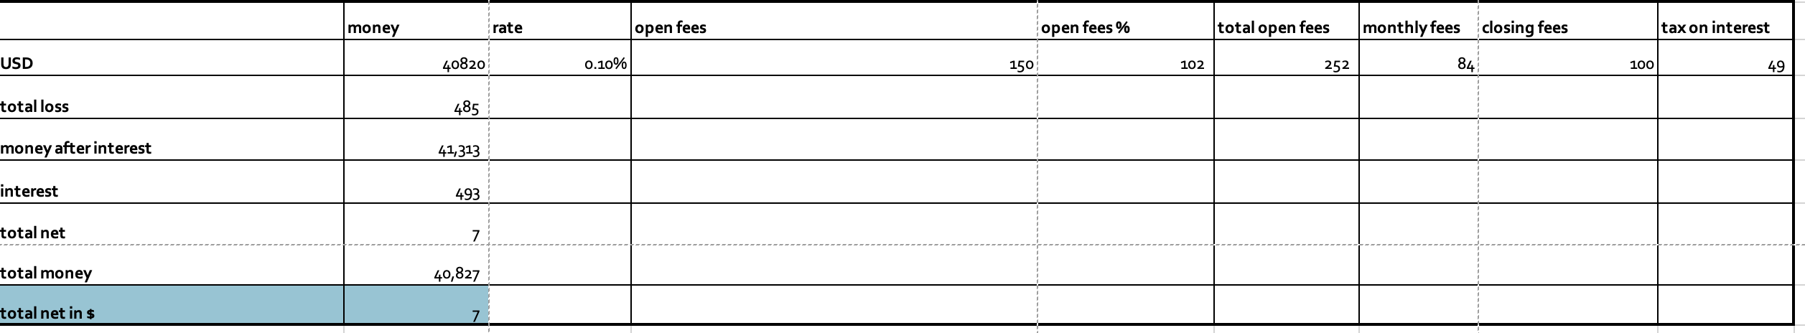
BANKING MARKET: USD CASE

Slide 12
TO CONCLUDE THIS ATTACHMENT, WE GAINED 4686+7= 4693$ by profting 150 000$ into the banking market

Slide 13
02. REAL ESTATE market

Slide 14
AFTER CLOSE CONSIDERATION ON ALL OF THE SECTORS, SECTOR C SEEMS TO BE THE BEST INVESTMENT By investing 425,000$ in the commercial option, we’ll be generating a total net of 12 750$

Slide 15
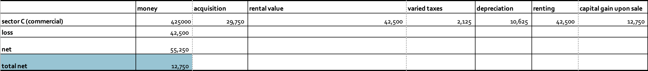
REAL ESTATE 425,000$ INVESTMENT

Slide 16
03. stock market: us AND EUROPEAN market

Slide 17
STOCKS IN US MARKET

Slide 18
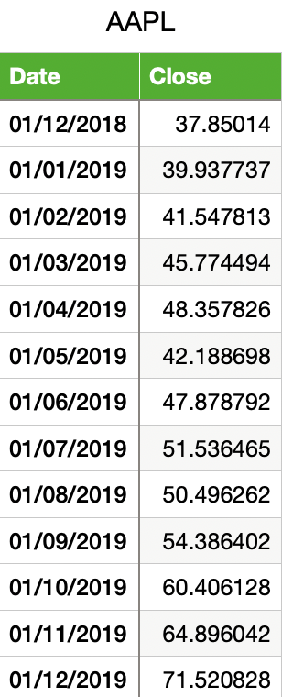
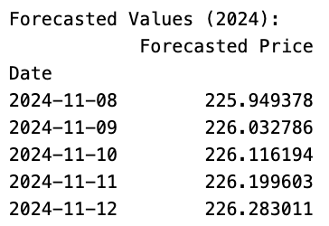
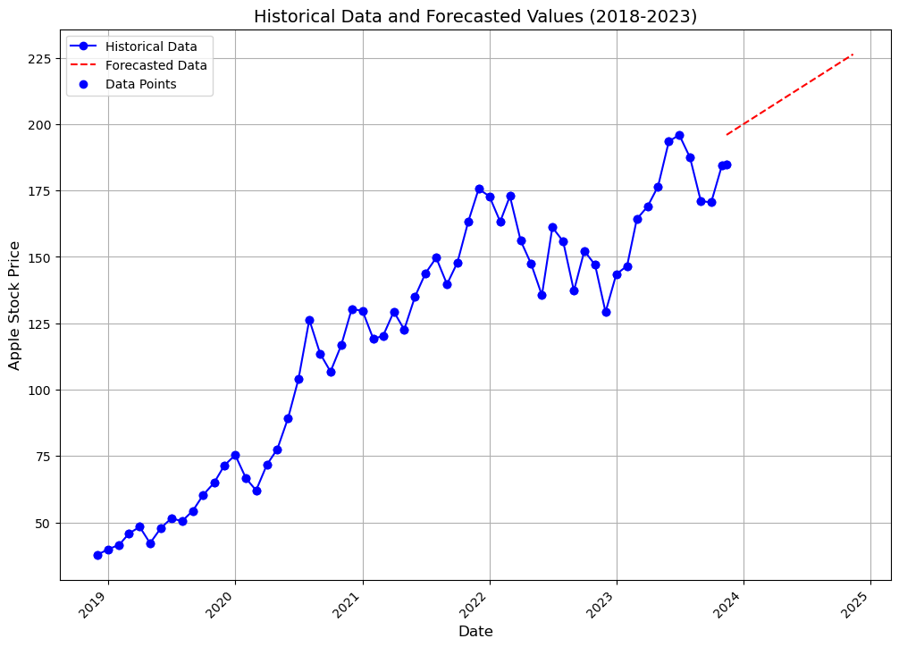
historical DATA (5y)
APPLE stock
Forecasted DATA
CURRENT stock price: 184,8$

Slide 19
APPLE
s
50,640 (INVESTMENT)-253.2$(opening tax)= 50,368.8$ (MONEY AFTER TAX)
50368 -> 61,675 (TOTAL AFTER A YEAR)-308(closing tax) =61,366$ (TOTAL MONEY)
Total net= 61,366-50,640=10,980$ (PROFIT)

Slide 20
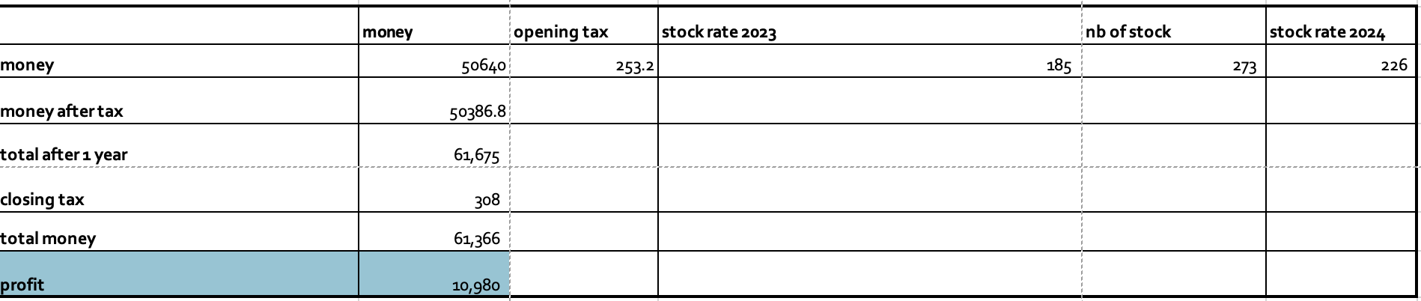
APPLE STOCK

Slide 21
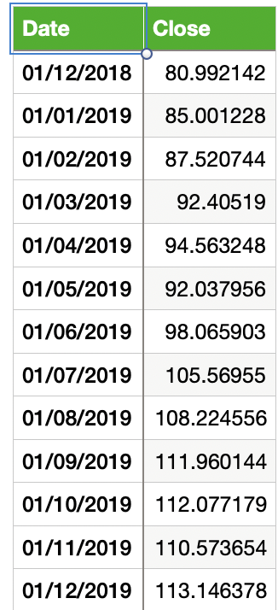
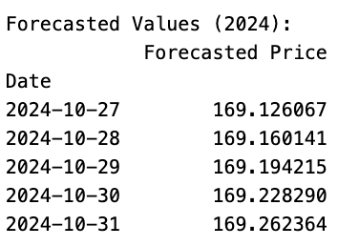
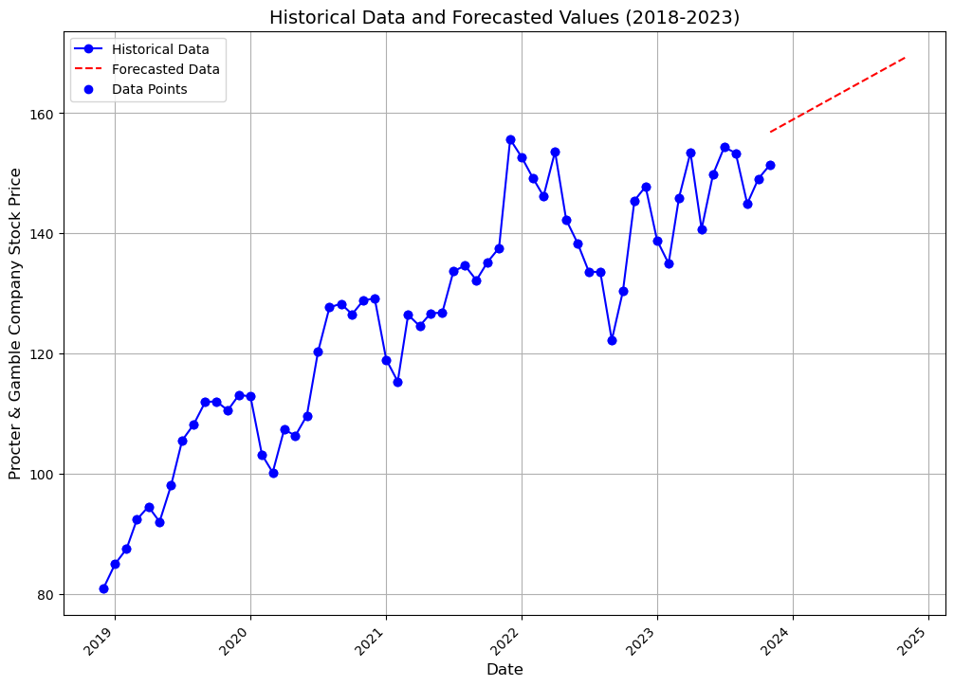
FORECASTED DATA
PROCTER & GAMBLE stock
Historical DATA (5y)
CURRENT stock price: 152$

Slide 22
PROCTER AND GAMBK
50,000 (INVESTMENT)-250$(opening tax)= 49750$ (MONEY AFTER TAX)
49750-> 55,314(TOTAL AFTER A YEAR)-277(closing tax) =55,038$ (TOTAL MONEY)
Total net= 55038-49750=5,288$ (PROFIT)

Slide 23
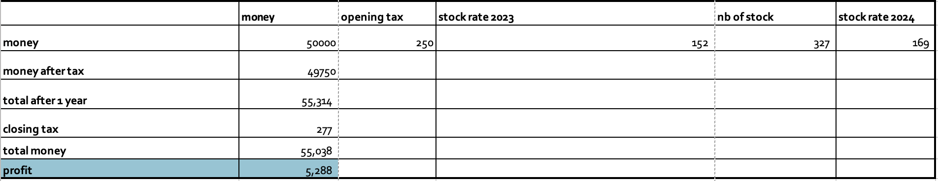
PROCTER AND GAMBLER STOCK

Slide 24
Stocks in EURO MARKET

Slide 25
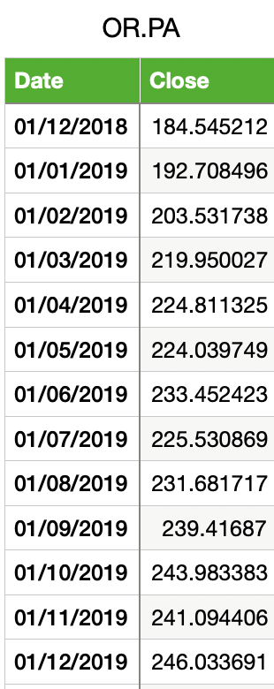
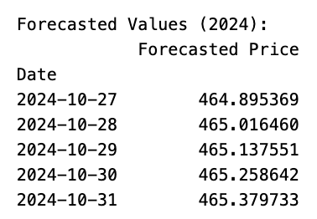
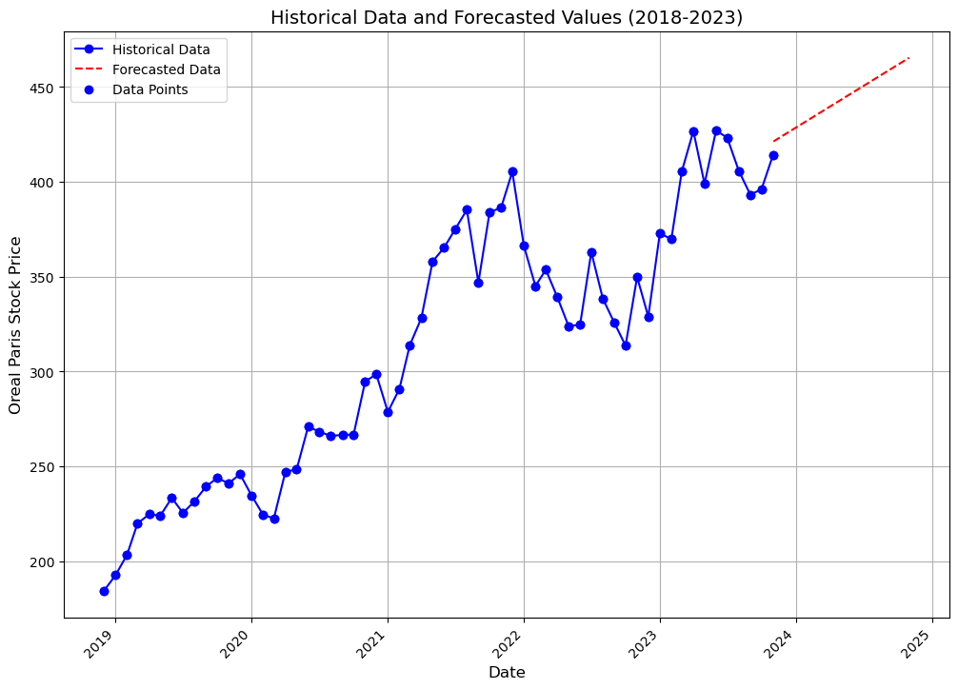
FORECASTED DATA
L'Oréal stock
Historical DATA (5y)
CURRENT stock price: 416 euro

Slide 26
L’OREAL STOCK
162180 (INVESTMENT)-810,9$(opening tax)= 161369$ (MONEY AFTER TAX)
194,846 (TOTAL AFTER A YEAR)-974(closing tax) = 193,872 (total in euro)
213,259$ (TOTAL MONEY in dollar )
(PROFIT in euro)-> 51079
213259-171910= 41,348$ profit $

Slide 27
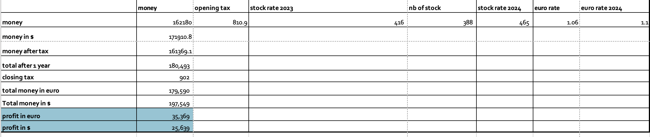
L’OREAL STOCK

Slide 28
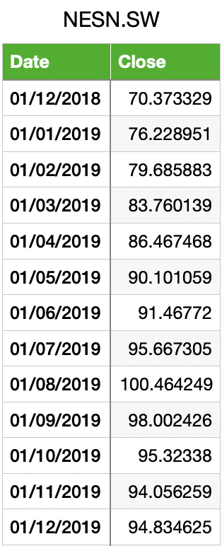
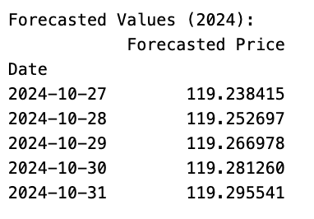
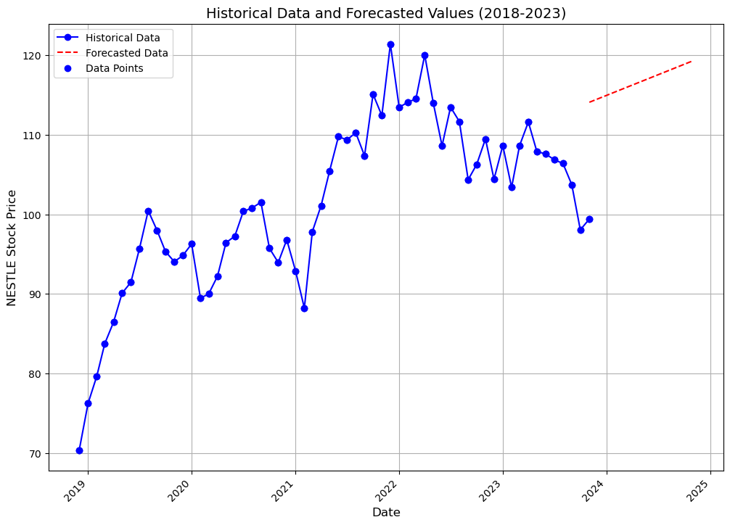
FORECASTED DATA
Nestle stock
Historical DATA (5y)
CURRENT stock price: 98.72 euro

Slide 29
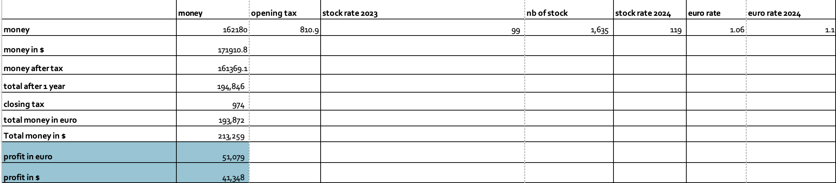
NESTLE STOCK

Slide 30
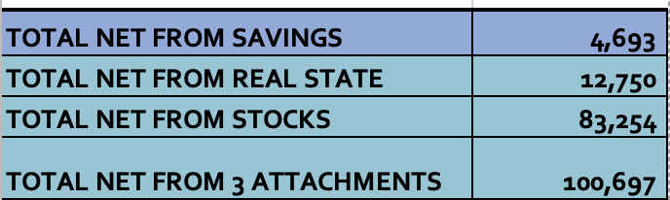
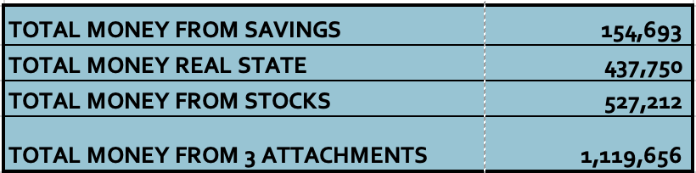
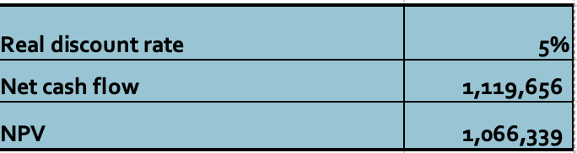
Totals
NPV=net cash flow/(1+r)

Slide 31
nvp
1,066,339 NVP
a positive NPV is a positive signal for an investment, indicating that it is expected to be financially beneficial.

Slide 32
ADVANTAGES
01 Risk Mitigation:
02 Stability and Consistency
03
Passive Income Opportunities
04
needs
By diversifying, you spread your risk across various sectors
By diversifying, you create a more stable and consistent income stream, even if one asset class underperforms.
Real estste and stocks
Stocks are generally more liquid than real estate, while banking investments provide easy access to cash. Having a mix of liquid and less liquid assets allows you to meet short-term financial needs without having to sell long-term investments at unfavorable times.

Slide 33
DISADVANTAGE
Lack of Guaranteed Returns:
No Assured Profits: Unlike saving money in a bank account, investments do not guarantee returns. There is always the risk of losing some or all of the invested capital.

Slide 34
THANK YOU FOR YOUR ATTENTION!!

